Slide 1
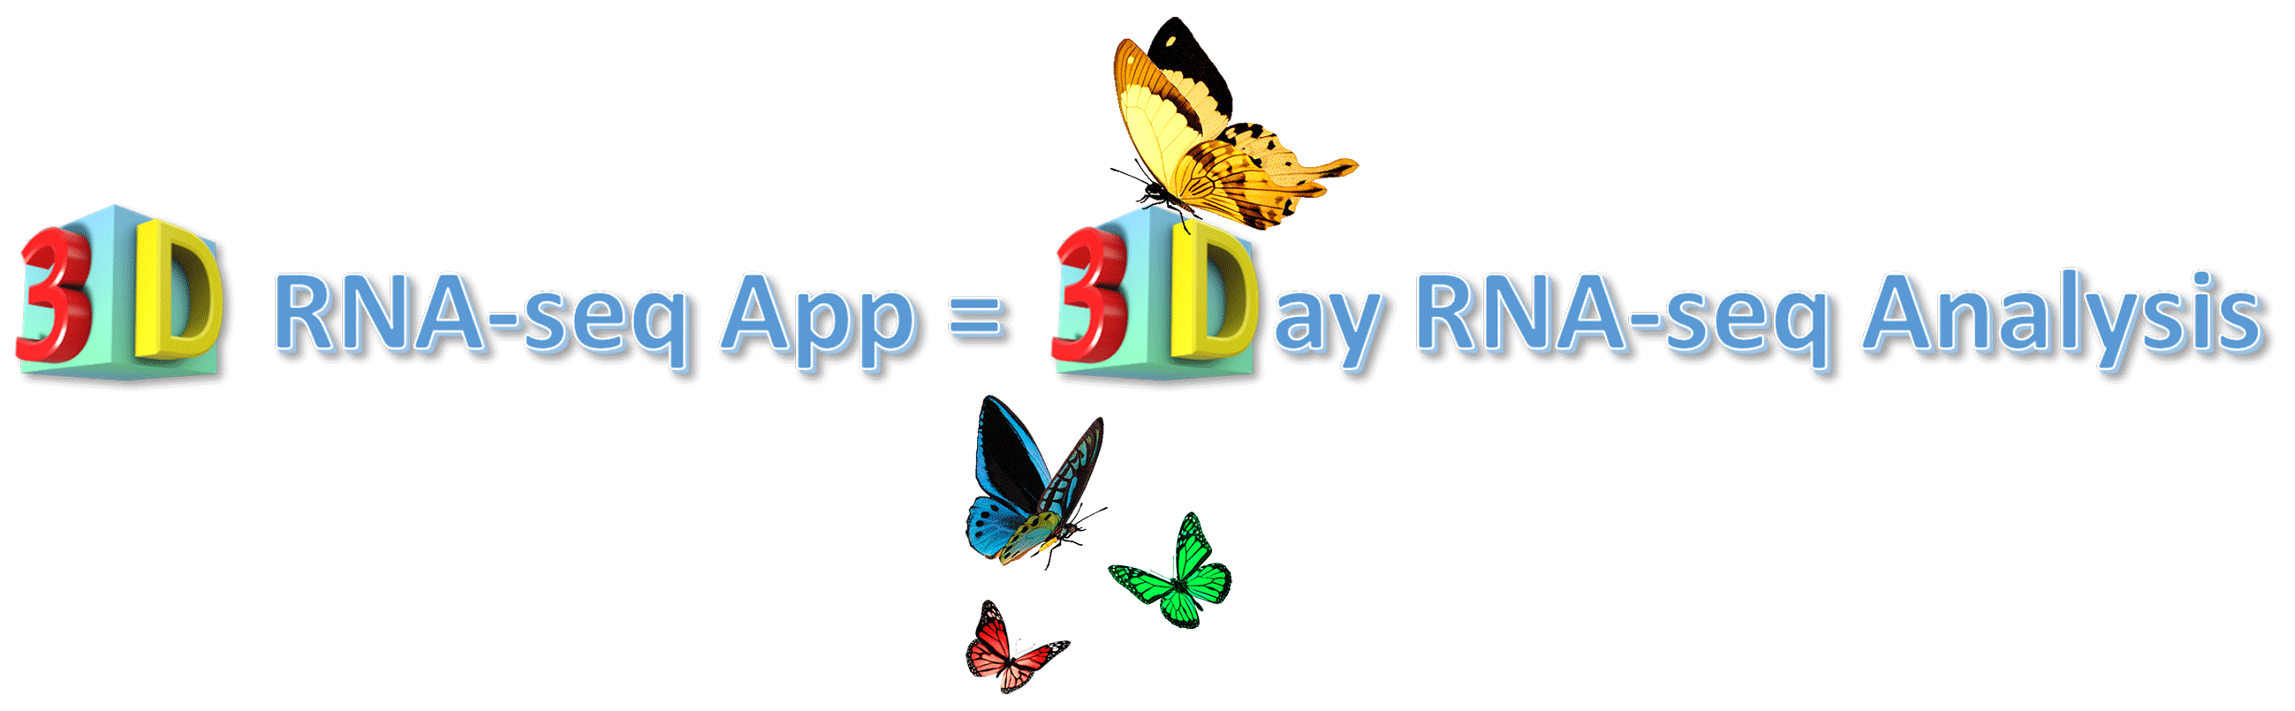

Dr. Runxuan Zhang
Dr. Wenbin Guo
12 December 2018

Slide 2

What is 3D RNA-seq?
An program for differential gene expression and alternative splicing
analysis of RNA-seq data designed for speed, accuracy and ease of use
3D RNA-seq allows
Accurate and rapid analysis of RNA-seq data
Analysis of differential expression/alternative splicing at the gene and transcript level
Easy to use graphical interface which can be used by non-bioinformatcians
Report with data visualisation (heat-maps, GO analysis etc)

Slide 3
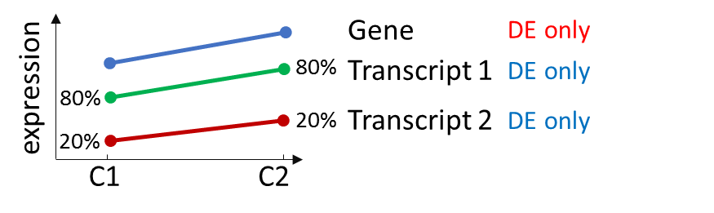
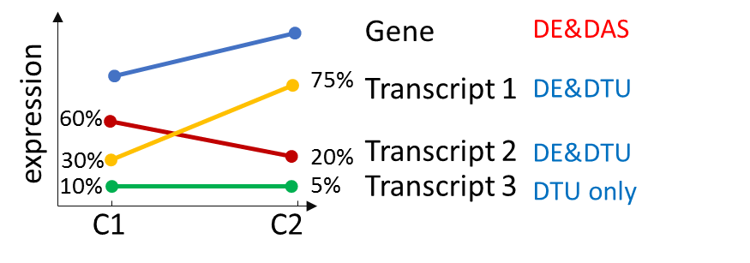
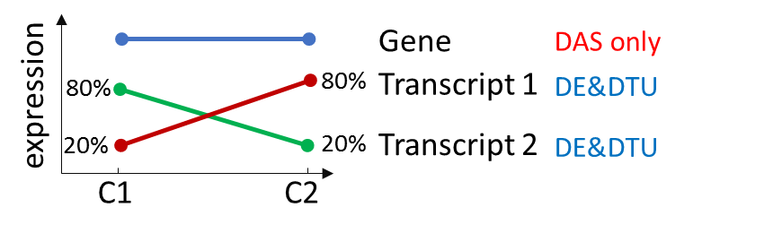
What is 3D RNA-seq?
Comparative expression analysis based on RNA-seq (3D):
Differential expression (DE)
Differential alternative splicing (DAS)
Differential transcript usage (DTU)
The whole analysis only takes 3 Days (3D):
Transcript quantification using Salmon, Kallisto, etc. (1-2 Days)
“Mouse click” 3D analysis using 3D RNA-seq App (< 1 Day)
DE: abundance change between conditions
DAS gene: changes of this gene are different to its transcripts
DTU transcript: changes of this transcript are different to all the other transcripts

Slide 4
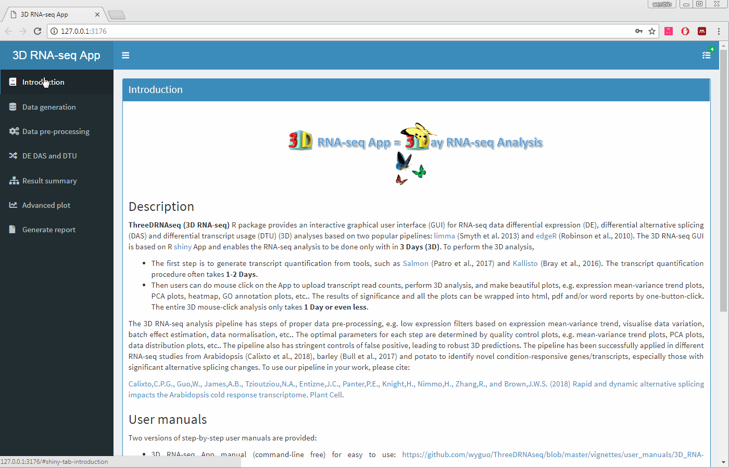
What is 3D RNA-seq?
A graphical user interface (GUI) based on R shiny App
Mouse click to load data, do 3D analysis, make plots, generate reports, etc.
Easy to use for both bioinformaticians and non-bioinformaticians

Slide 5
What does 3D RNA-seq App do?
Step 1: generate transcript read counts and TPM from Salmon/Kallisto quantifications
Step 2: Data pre-processing to reduce noise
Merge sequencing replicates
Filter low expressed genes/transcripts
PCA plot to check data variation
Correct batch effects
Data normalization
Step 3: 3D analysis (Options: limma-voom, edgeR pipeline)
Step 4: Summary results of significance
Step 5: Make plots (heatmap, expression profiles, GO annotation plot)
Step 6: One click to generate report (html, pdf and word format)
Robust 3D predictions
Good false positive controls
Transcript quantification
Generate read counts/TPMs
Data pre-processing
3D analysis
Results visualise
Report
Salmon, Kallisto, etc.
Tximport R package
Data quality control
Limma or edgeR
PCA, heatmap, GO, profiles

Slide 6
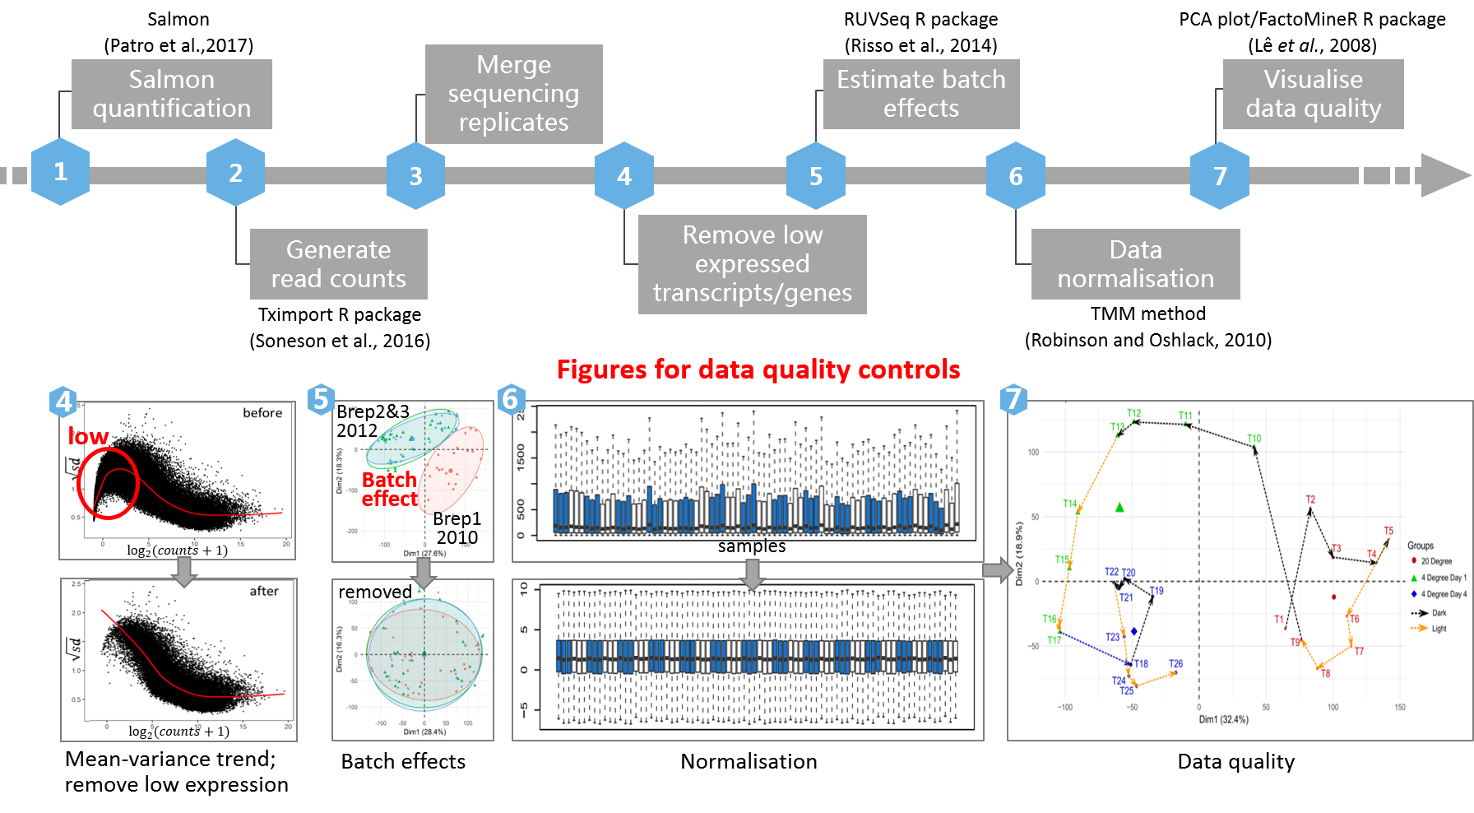
What does 3D RNA-seq App do?

Slide 7
How to start 3D RNA-seq App?
Cyvers ThreeDRNAseq App
xxxxx
James Hutton docker image
xxxxx
Open 3D RNA-seq App in RStudio (for basic R users),
user manual: https://github.com/wyguo/ThreeDRNAseq/blob/master/vignettes/user_manuals/3D_RNA-seq_App_manual.md
Do analysis on command line (for advanced R users),
User manual:
https://github.com/wyguo/ThreeDRNAseq/blob/master/vignettes/user_manuals/Command_line_based_manul.md
#Assume all dependency R packages are installed
library(ThreeDRNAseq)
ThreeDRNAseq.app()
# or
library(shiny)
runGitHub("ThreeDRNAseq", "wyguo",subdir = "app_full")

Slide 8
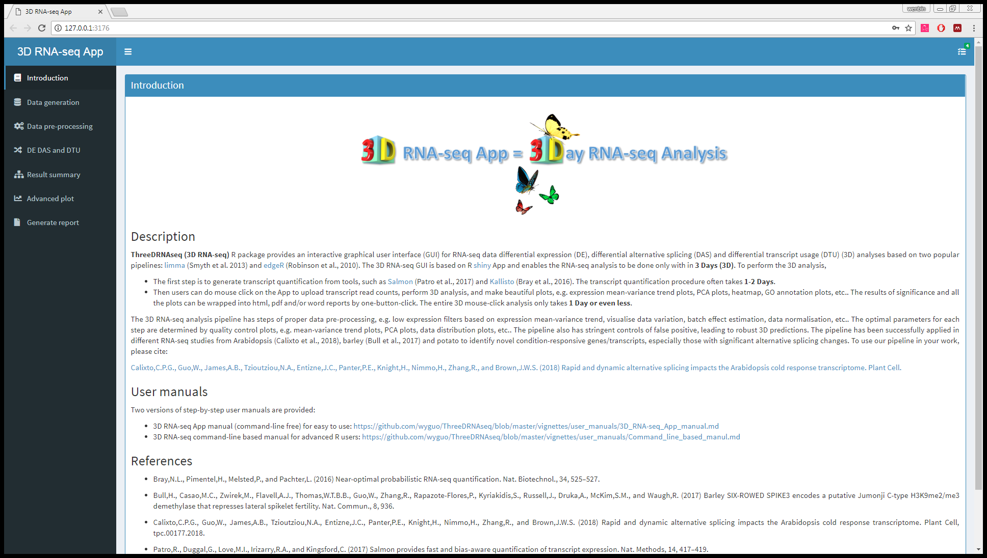
How to use 3D RNA-seq App?
Introduction page
Click data generation
Introduction page
Sidebar menu

Slide 9
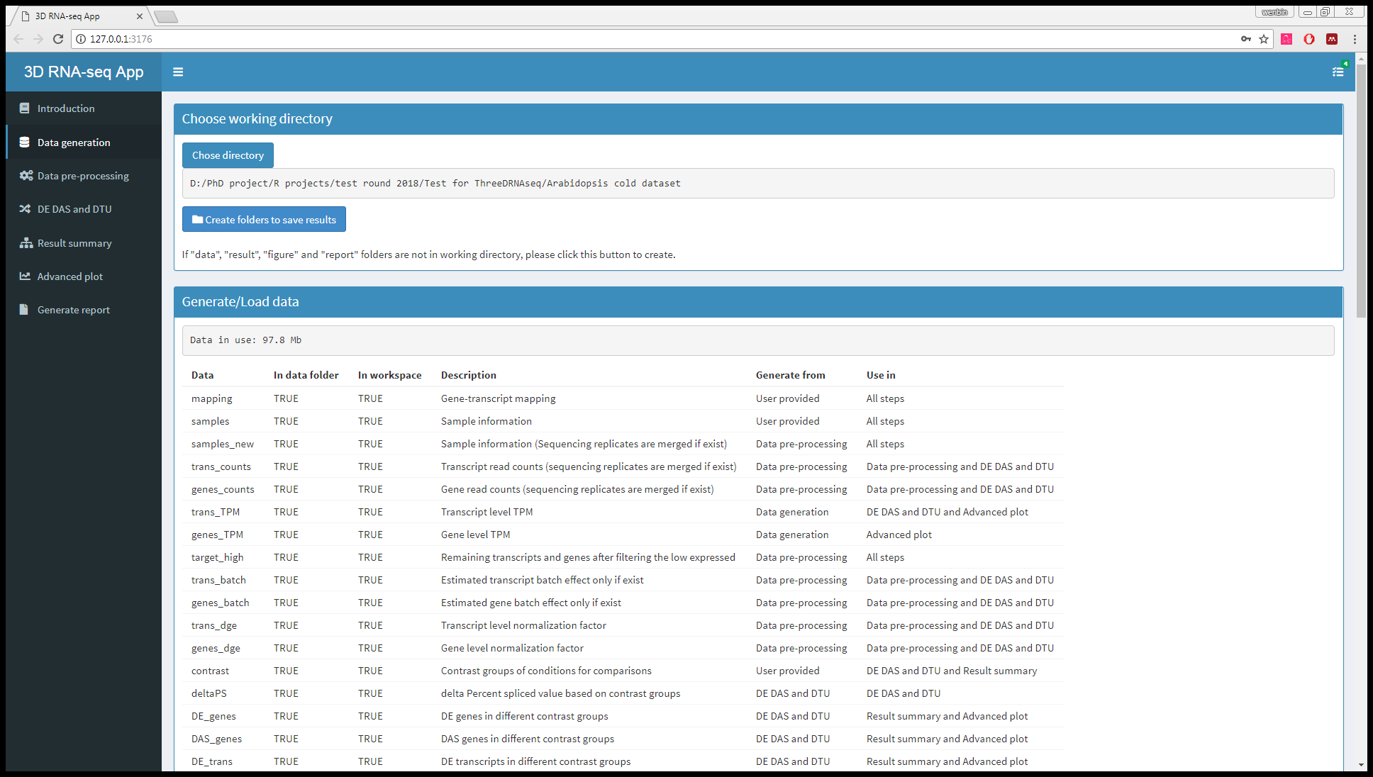
How to use 3D RNA-seq App?
Data generation page

Slide 10
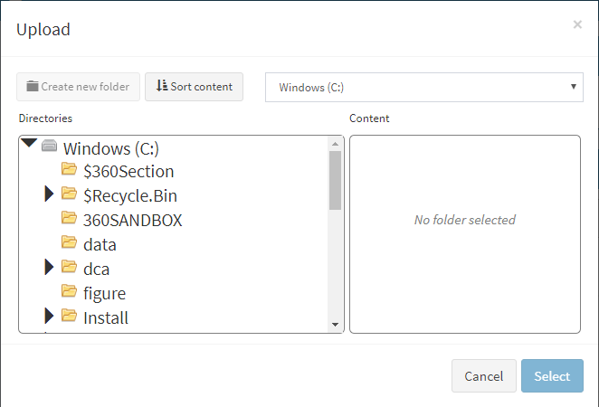
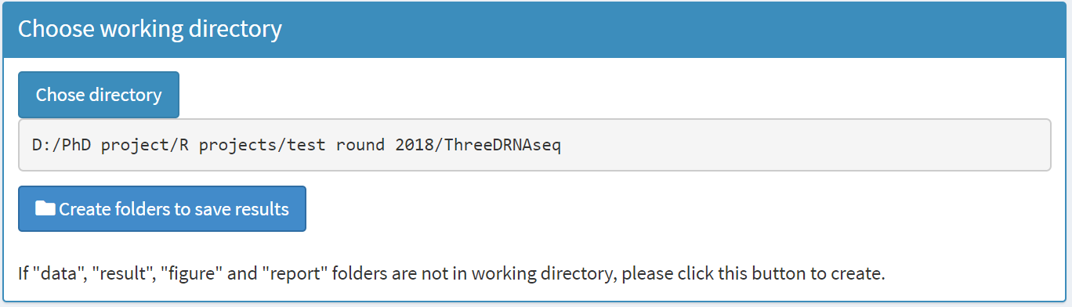
How to use 3D RNA-seq App?
Data generation page
Step 1: Select working directory
selectable
Click to select working directory
selectable
Click to generate folders to save results. Four folders, data, result, figure and report, are generated in working directory

Slide 11
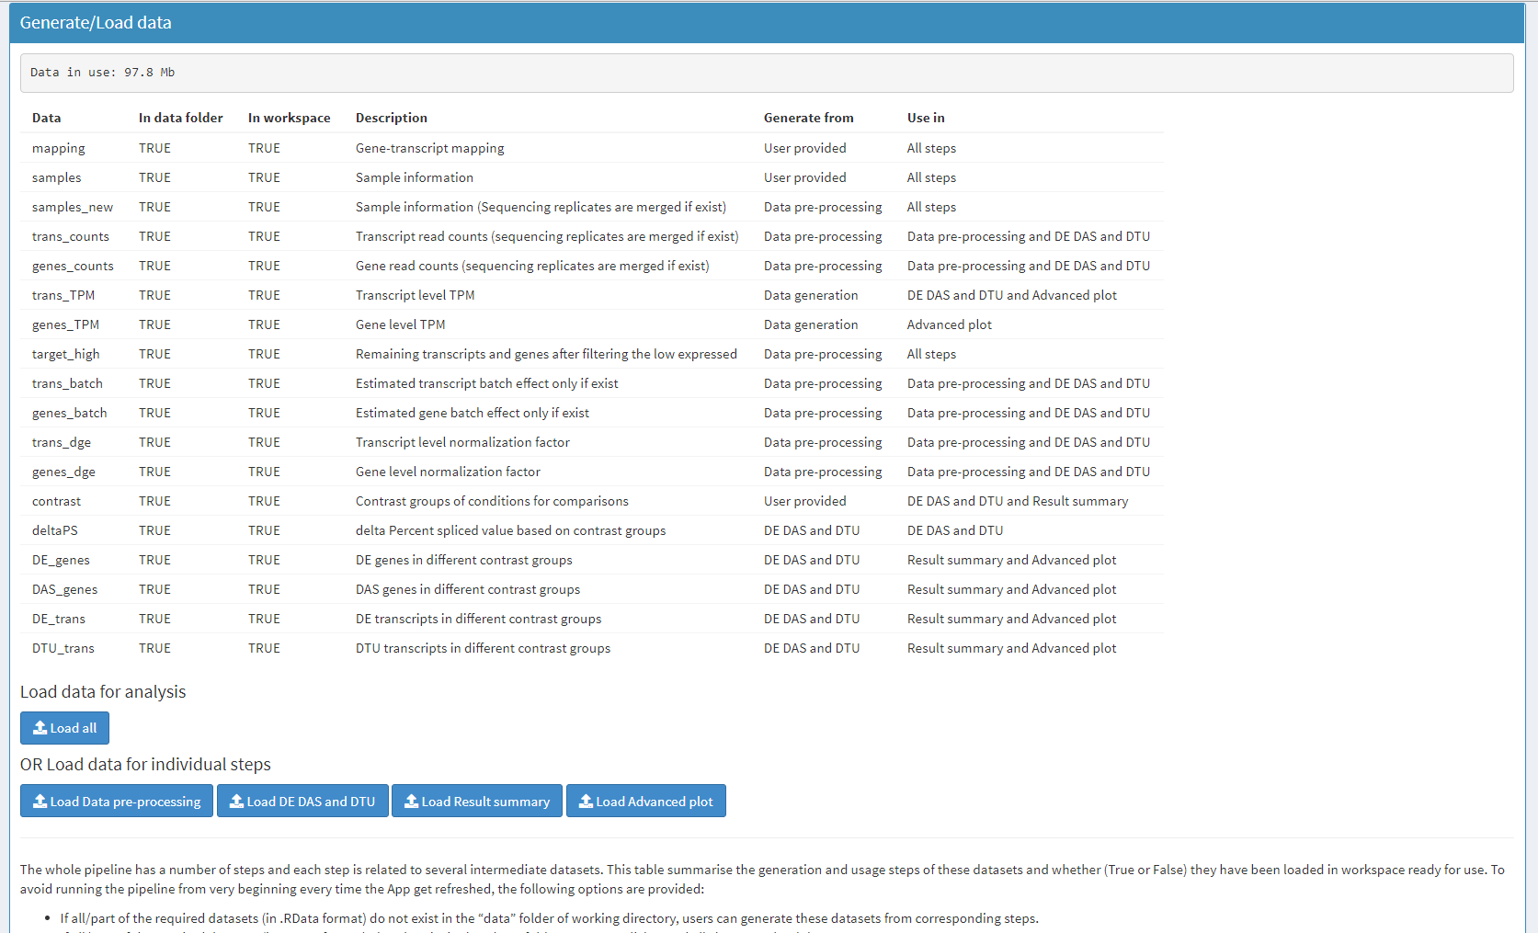
How to use 3D RNA-seq App?
Data generation page
Step 1: Select working directory
Summary of intermediate datasets in the analysis
Saved in data folder as .RData objects
Load these data directory from data folder to avoid re-doing the analysis every time the App get refreshed.

Slide 12
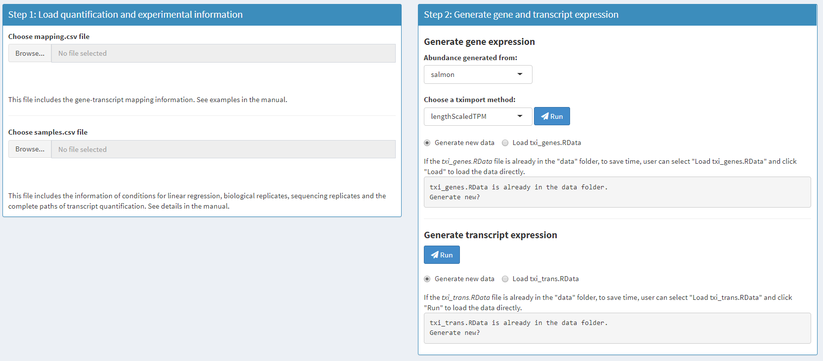
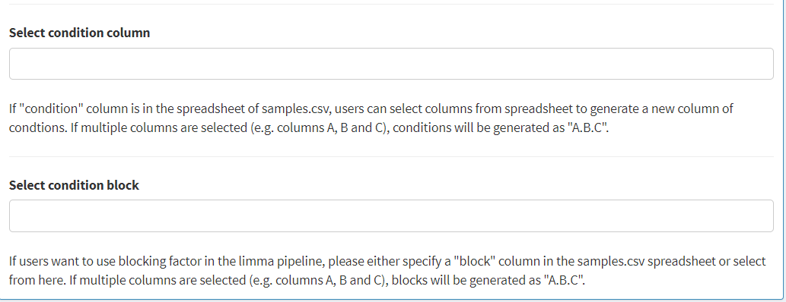
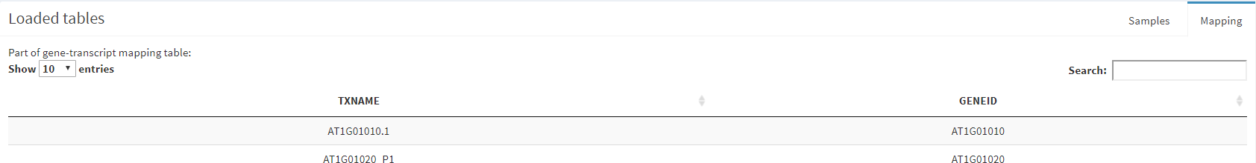
How to use 3D RNA-seq App?
Data generation page
Step 2: Generate read counts/TPMs from Salmon
Select the transcript quantification type, e.g. Salmon, Kallisto
Load gene-transcript mapping here
Select tximport method, lengthScaledTPM is recommended
Use tximport R package to generate transcript/gene expression
Load sample information here
If the .RData object of expression are already in data folder, can load directly
If condition/block column is not in the sample.csv file, please specify here
Spreadsheet of transcript-gene mapping, sample information

Slide 13
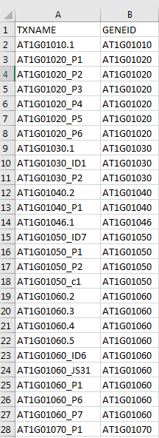
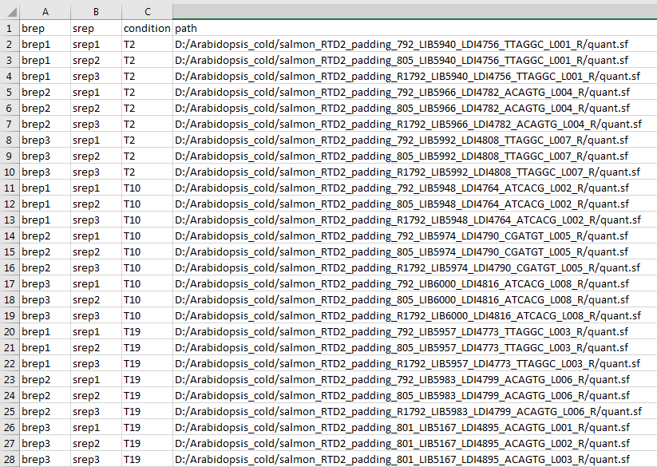
How to use 3D RNA-seq App?
Data generation page – prepare input csv files
Step 2: Generate read counts/TPMs from Salmon
Transcript-gene mapping csv
Sample information csv
Transcripts
Gene
Labels of biological replicates
Labels of sequencing replicates
Complete path of Salmon quantification files (quant.sf)
Labels of conditions

Slide 14
How to use 3D RNA-seq App?
Data generation page
Click data pre-processing

Slide 15
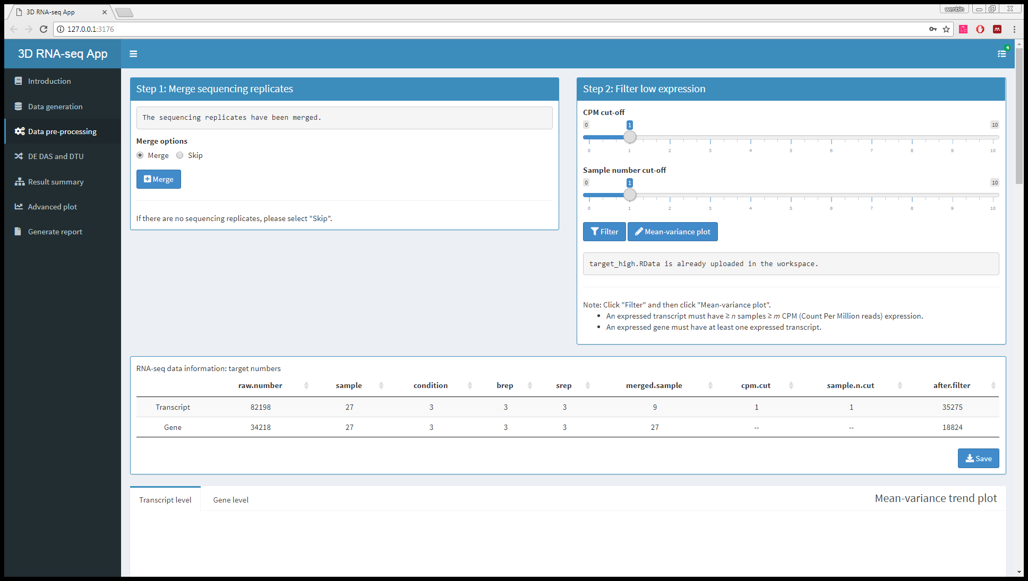
How to use 3D RNA-seq App?
Data pre-processing page

Slide 16
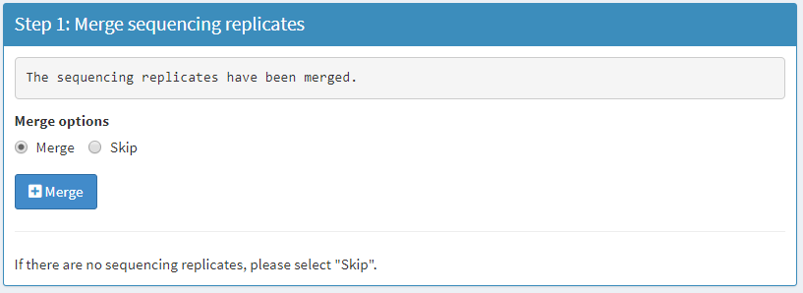
How to use 3D RNA-seq App?
Data pre-processing page
Step 1: Merge sequencing replicates
If the dataset has no sequencing replicates, please select Skip
The sequencing replicates are generated by sequencing the same biological replicate multiple times, which do not add too much information to the technical variation. Sequencing replicates from the same biological replicate are often added to increase the depth.

Slide 17
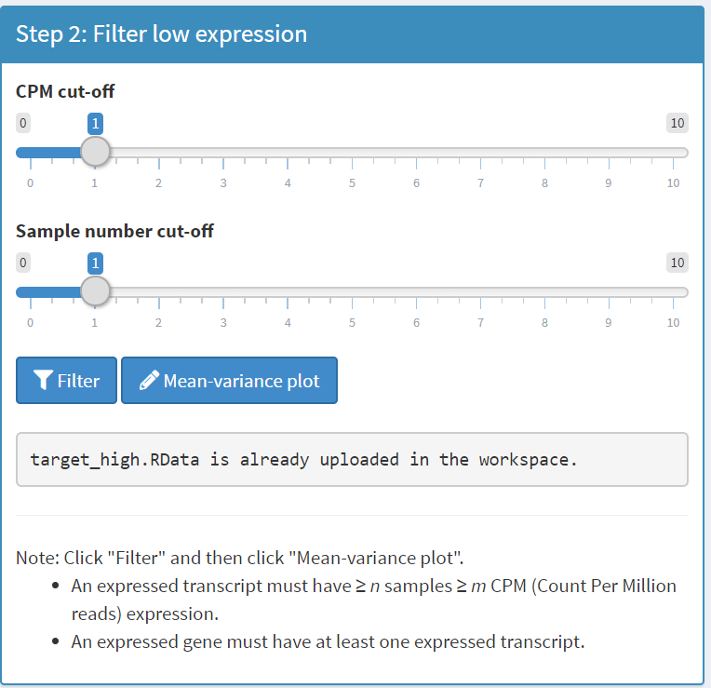
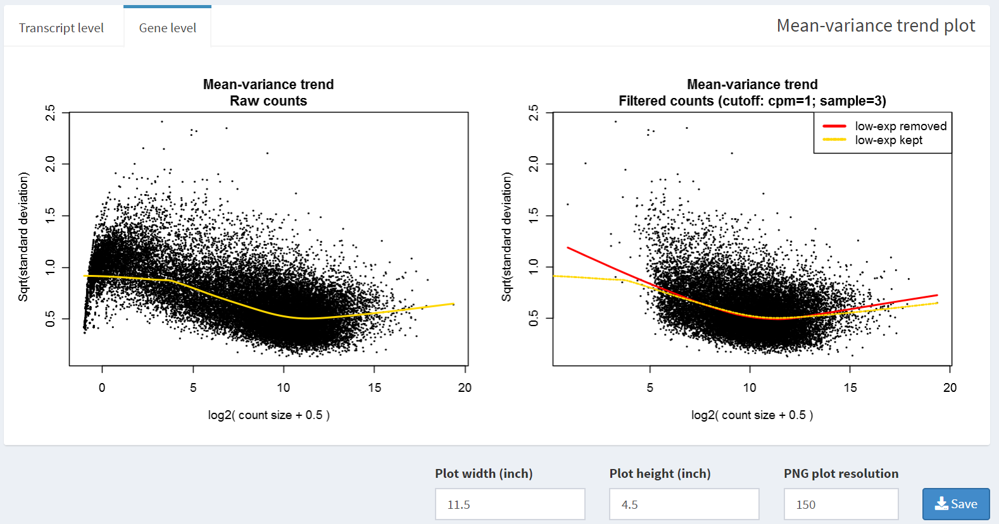
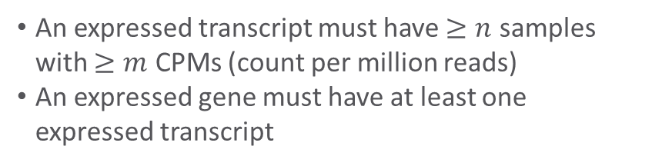
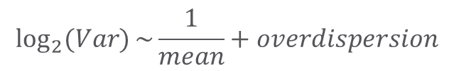
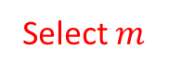

How to use 3D RNA-seq App?
Data pre-processing page
Step 2: Filter low expressed transcripts/genes
An expressed transcript must have $≥n$ samples with $≥m$ CPMs (count per million reads)
An expressed gene must have at least one expressed transcript
Select threshold to filter
Select $n$
Select $m$
Varing low expressed cut-offs until the drop trend disappear
Mean-variance trend plot
Drop trend at low expressed region
Mean-variance monotonically decreasing trend
Save the plot to local figure folder. Width, height and resolution of the saved plot can be set here
$$\log_{2}{(Var)}\sim \frac{1}{mean}+overdispersion$$

Slide 18
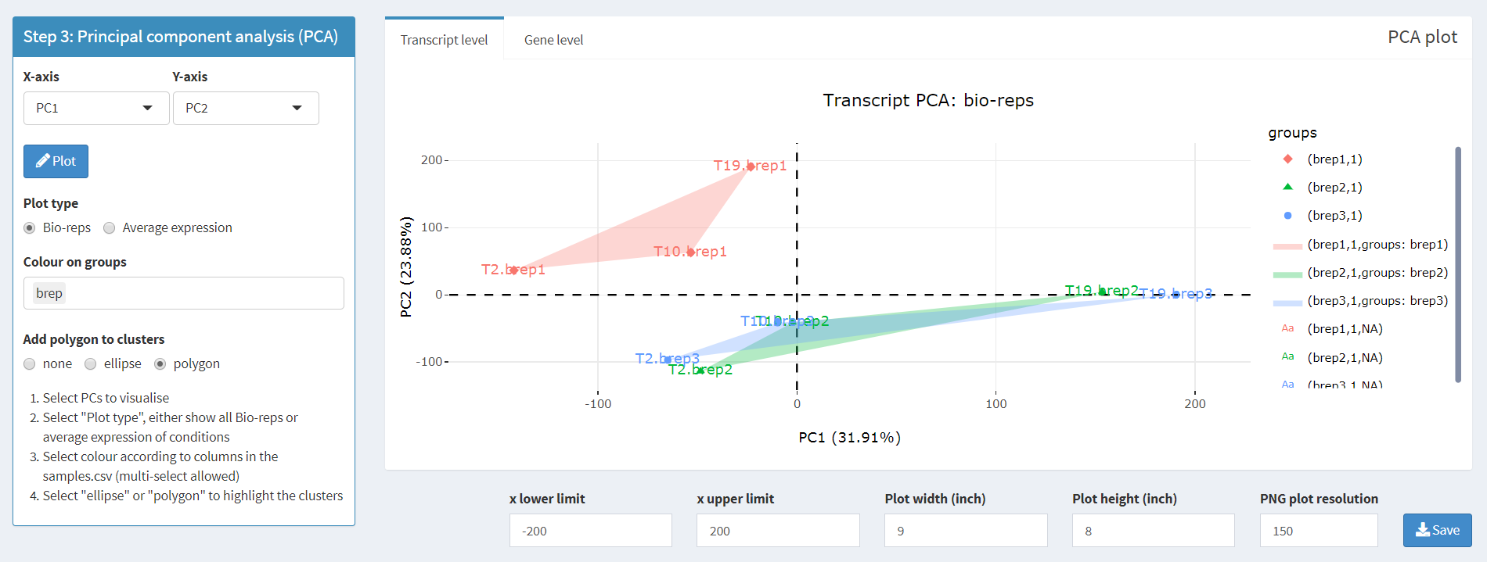
How to use 3D RNA-seq App?
Data pre-processing page
Step 3: PCA plot: data variation and batch effects
If the dataset has batch effects between biological replicates, Go To “Step 3 – Continued”
Select PCs for x- and y-axis
Plot all biological samples or average expression
PCA plot of all biological samples
Select gene/transcript level
Bio-rep1
Batch effects
Bio-rep3
Bio-rep2
Add colour shadow to the plot
Select one or multiple factors according to the columns of sample information csv to group the scatter points
Save the plot to local figure folder. X-axis limits, width, height and resolution of the saved plot can be set here

Slide 19
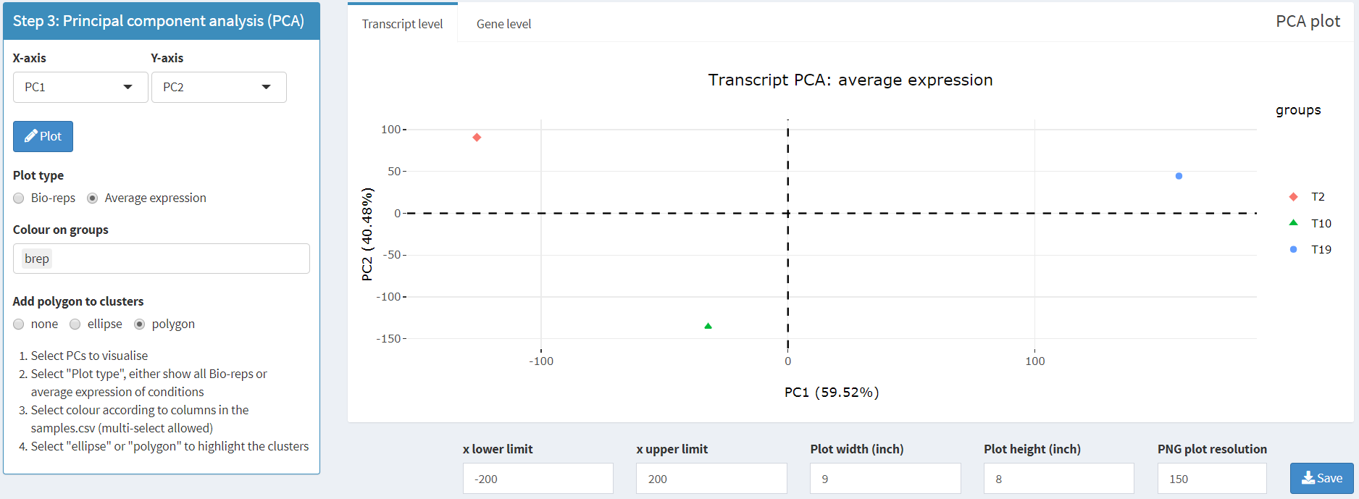
How to use 3D RNA-seq App?
Data pre-processing page
Step 3: PCA plot: data variation and batch effects
Select PCs for x- and y-axis
Plot all biological samples or average expression
PCA plot of average expression
Select gene/transcript level
T2
T19
T10
Add colour shadow to the plot
Select one or multiple columns in the sample information csv to group the scatter points
Save the plot to local figure folder. X-axis limits, width, height and resolution of the saved plot can be set here

Slide 20
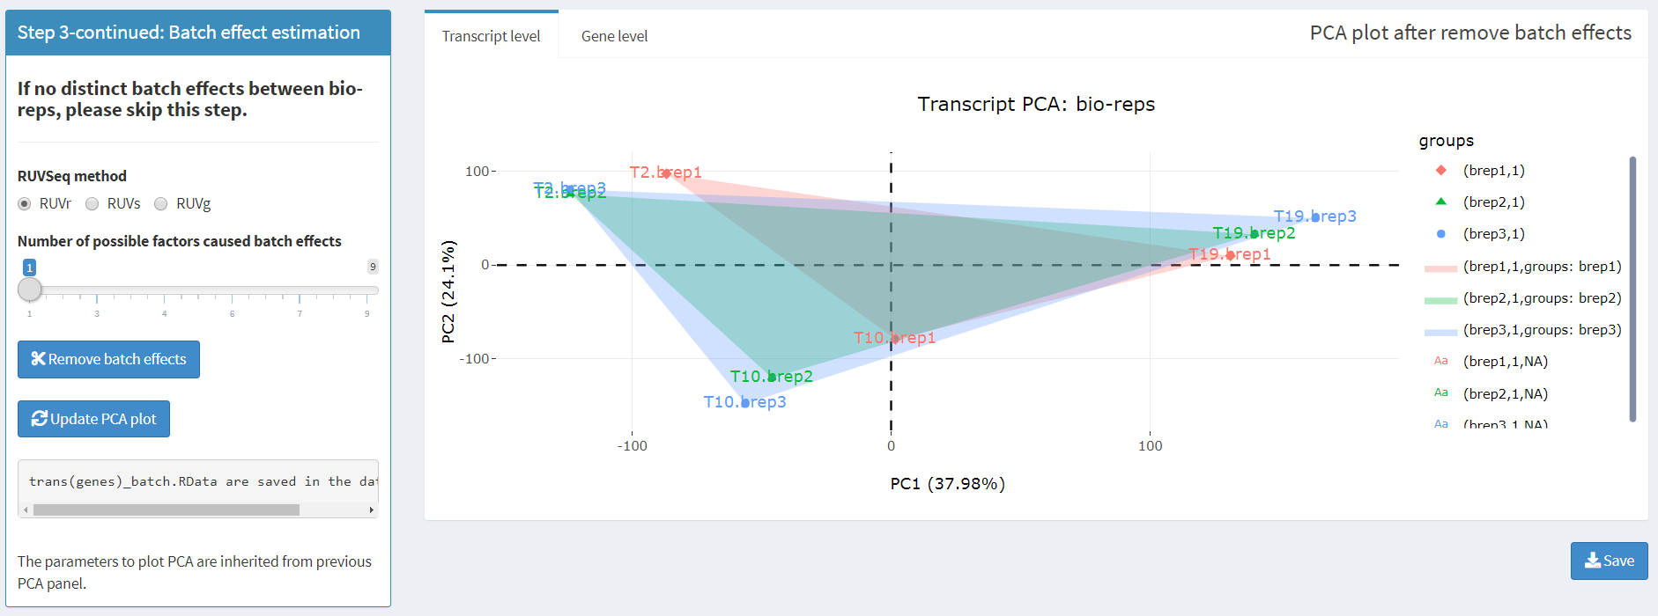
How to use 3D RNA-seq App?
Data pre-processing page
Step 3-continued: batch effect estimation
Select batch effect estimation method in RUVSeq R package (see package for details)
Batch effect has been removed
Number of possible factors causing batch effects
Bio-rep3
Bio-rep2
Estimate batch effect and update PCA plot
Bio-rep1
The parameters to plot PCA are inherited from previous PCA panel.

Slide 21
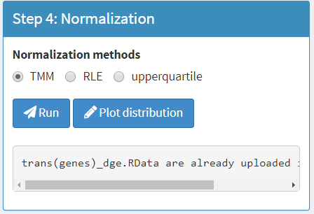
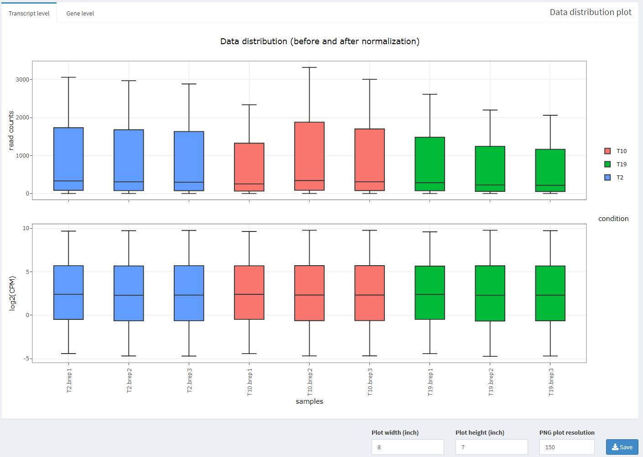
How to use 3D RNA-seq App?
Data pre-processing page
Step 4: data normalisation
Select gene/transcript level
Select a method to normalise read counts across samples. Options: TMM, RLE, upperquartile
(see Bullard et al., 2010 for details). TMM method is the most widely used one.
Save the plot to local figure folder. Width, height and resolution of the saved plot can be set here

Slide 22
How to use 3D RNA-seq App?
Data pre-processing page
Click DE DAS and DTU

Slide 23
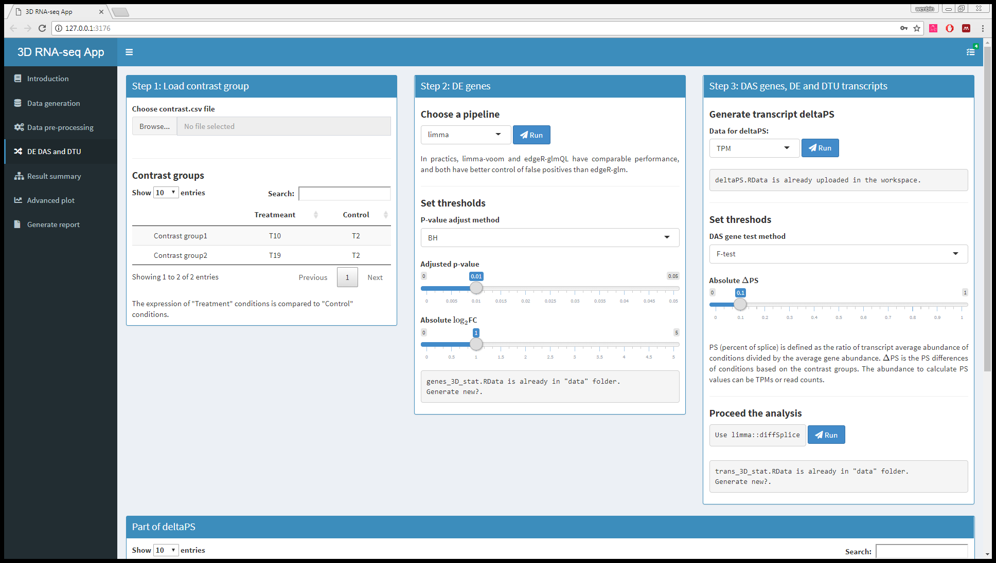
How to use 3D RNA-seq App?
3D analysis page

Slide 24
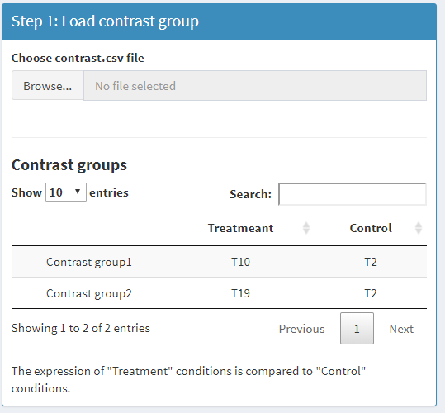
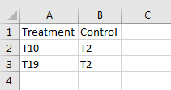
How to use 3D RNA-seq App?
3D analysis page
Step 1: Load contrast group from csv
Load contrast groups
contrast.csv spreadsheet; first column is treatment and second column is control
Visualise contrast groups

Slide 25
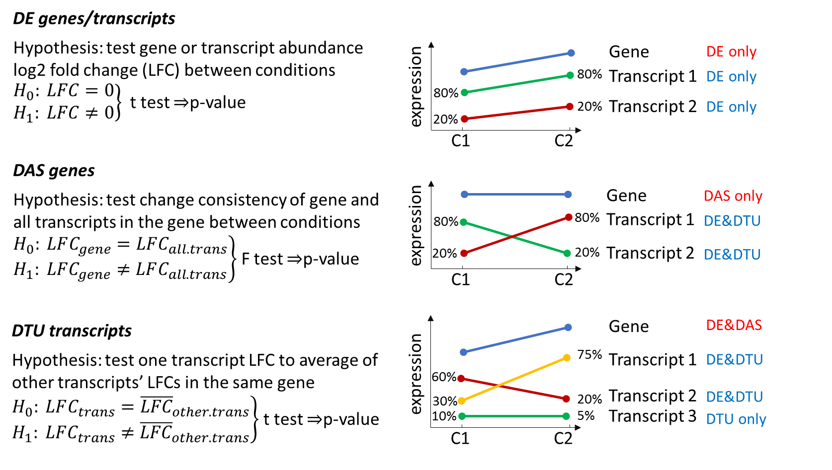
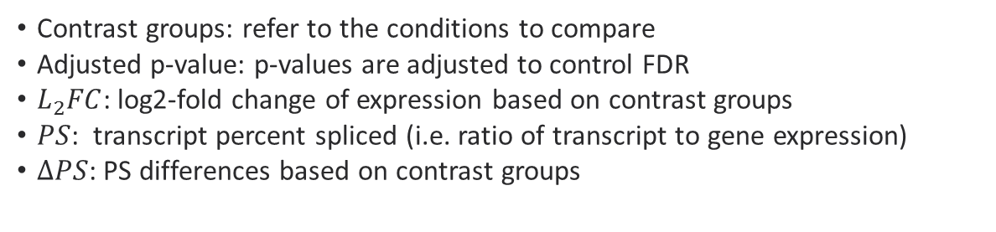
How to use 3D RNA-seq App?
3D analysis page
Definition of DE, DAS and DTU, and statistics
Contrast groups: refer to the conditions to compare
Adjusted p-value: p-values are adjusted to control FDR
$L_{2}FC$: log2-fold change of expression based on contrast groups
$PS$: transcript percent spliced (i.e. ratio of transcript to gene expression)
$ΔPS$: PS differences based on contrast groups

Slide 26
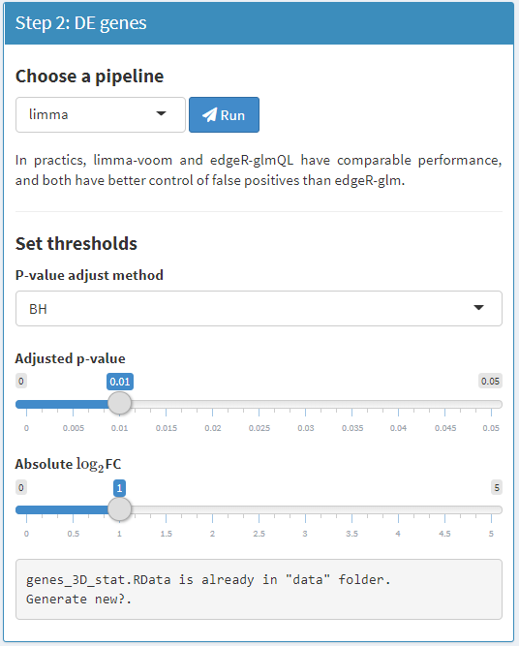
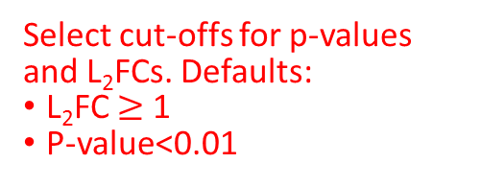
How to use 3D RNA-seq App?
3D analysis page
Step 2: DE gene analysis based on gene expression
A gene is identified as DE in a contrast group if L₂FC of expression ≥ cut-off and with adjusted p-value < cut-off (same to DE transcript).
Two pipelines are provided for DE analysis: “limma-voom” and “edgeR”. The edgeR pipeline includes two methods: glmQL and glm. Limma-voom and glmQL have comparable performance in practice and both have better FDR control than glm.
Note: the edgeR pipeline in this App is still being tested, so use limma-voom just now.
Select p-value adjust method
Select cut-offs for p-values and L₂FCs. Defaults:
L₂FC $≥$ 1
P-value<0.01

Slide 27
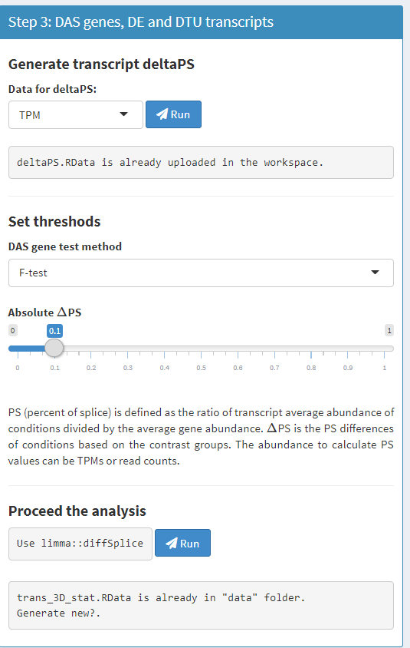
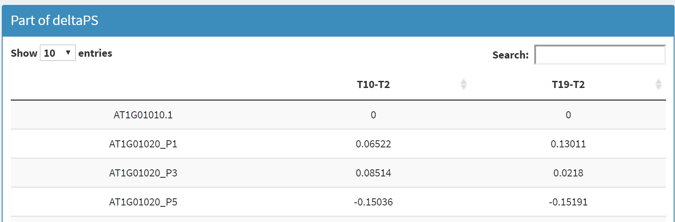

How to use 3D RNA-seq App?
3D analysis page
Select abundance type to for $ΔPS$
Select method to summarise gene-level DAS p-values

Slide 28
How to use 3D RNA-seq App?
3D analysis page
Click Result summary

Slide 29
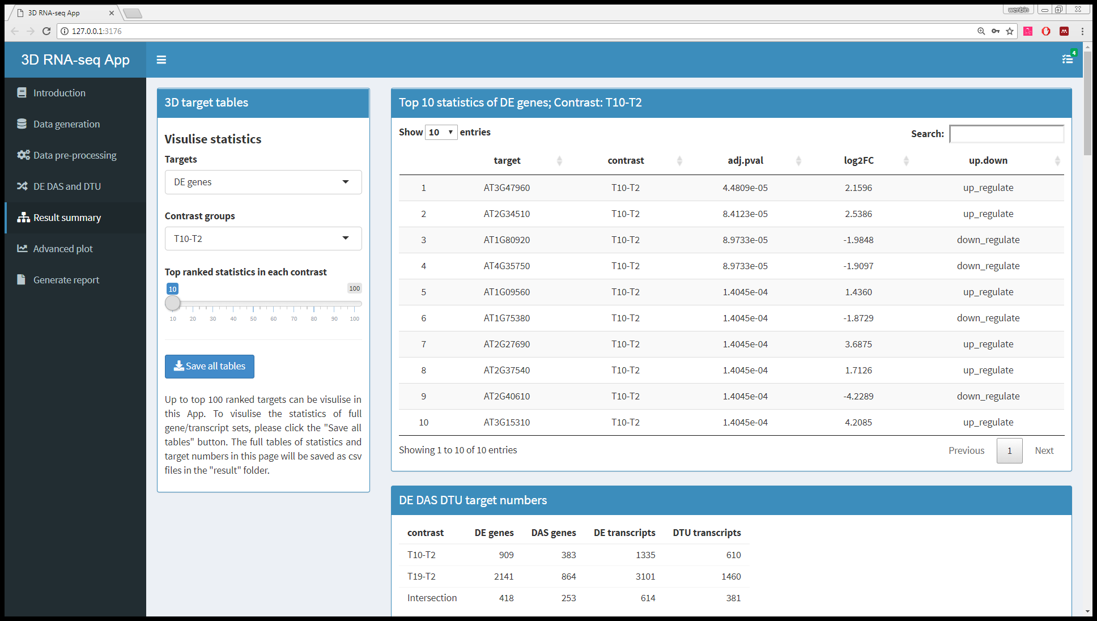
How to use 3D RNA-seq App?
Result summary page

Slide 30
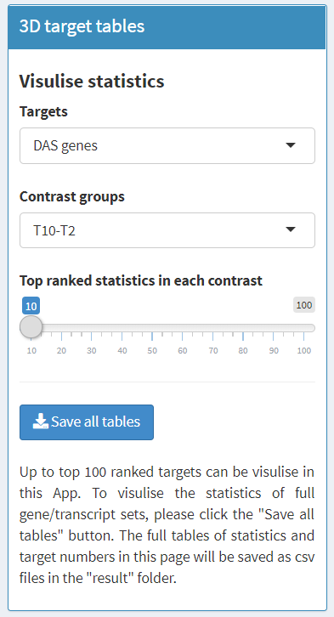
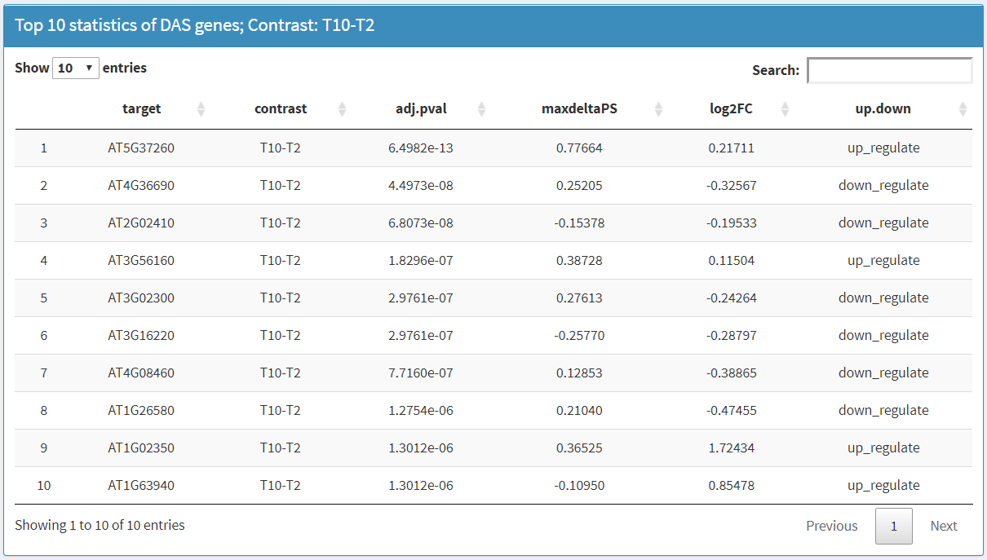
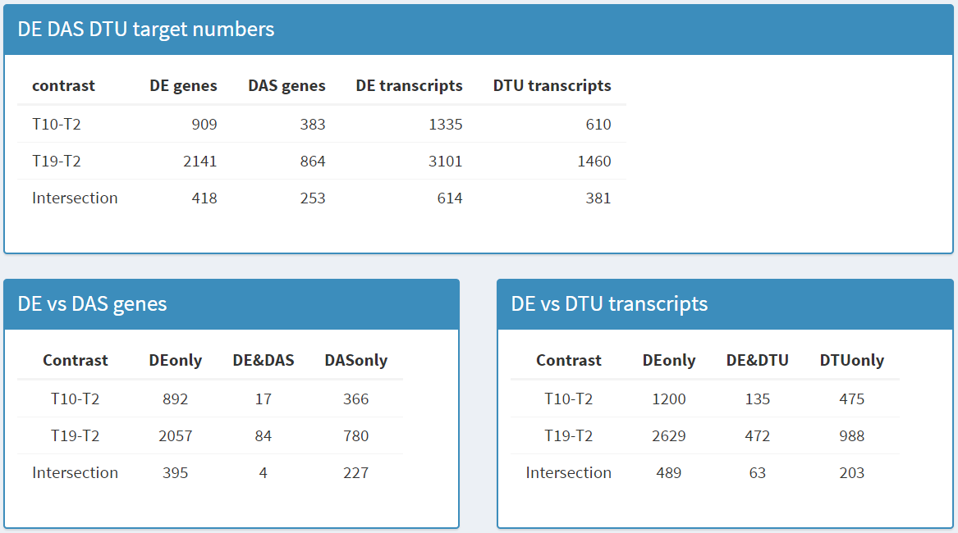
How to use 3D RNA-seq App?
Result summary page – Results of significance
Statistics of significance
3D number in different contrast groups
Select and visualise tables. All tables can be saved to “result” folder.

Slide 31
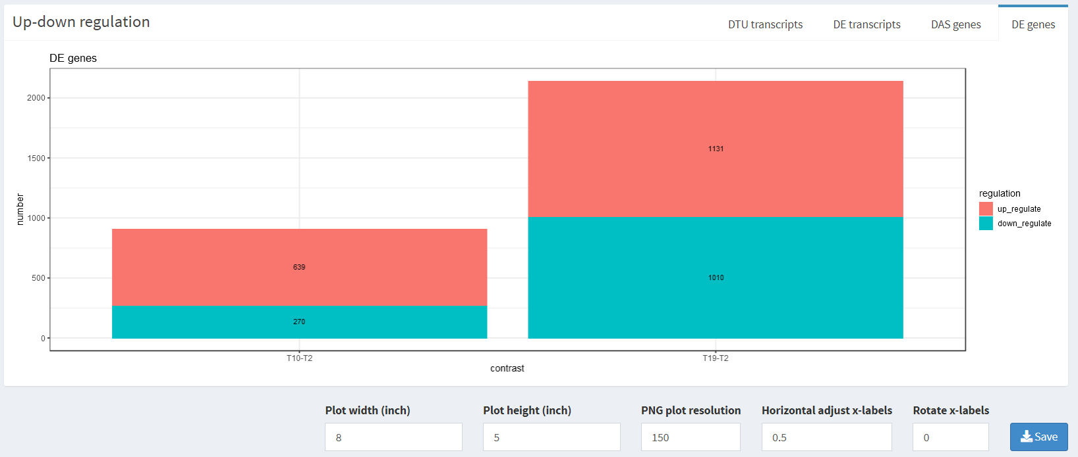
How to use 3D RNA-seq App?
Result summary page – Plot of significance
Select and visualise
Bar plot of up-down regulation
Save the plot to local figure folder.
Set size of the saved plot.
Adjust x-axis label position and angle.

Slide 32
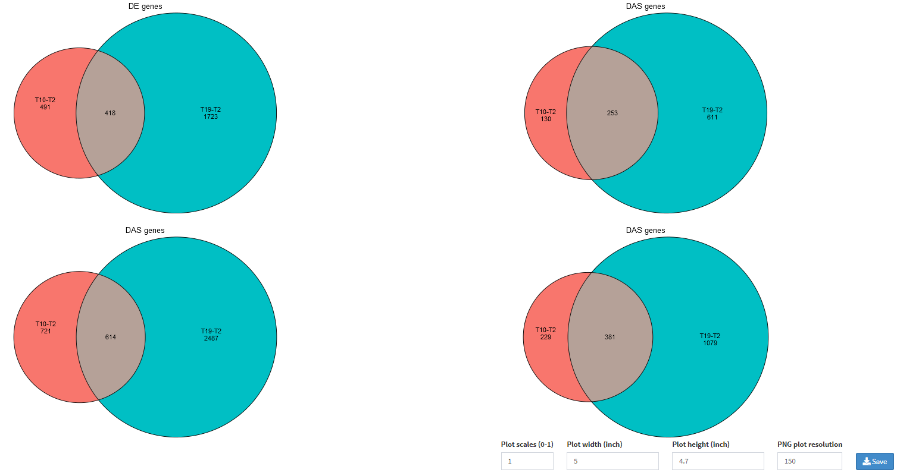
How to use 3D RNA-seq App?
Result summary page – Plot of significance
Select multiple contrast groups to make Euler diagram
Save the plot to local figure folder.
Set size of saved plot.

Slide 33
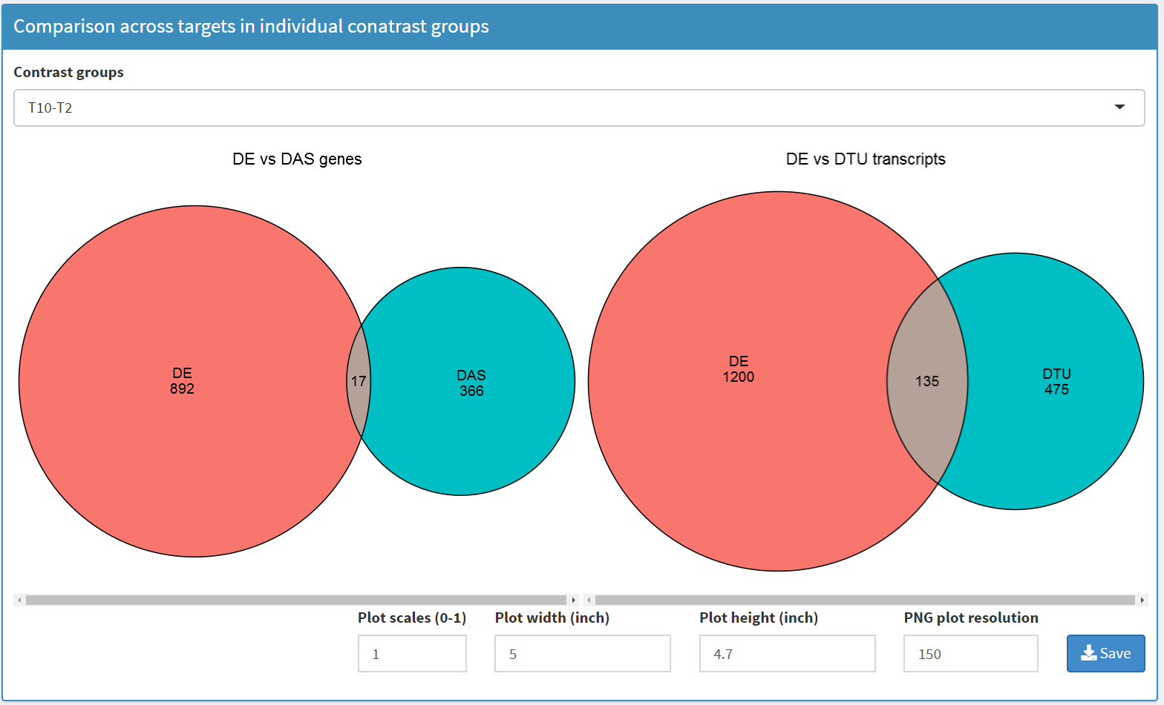
How to use 3D RNA-seq App?
Result summary page – Plot of significance
Select a contrast group to make Euler diagram
Save the plot to local figure folder.
Set size of saved plot.

Slide 34
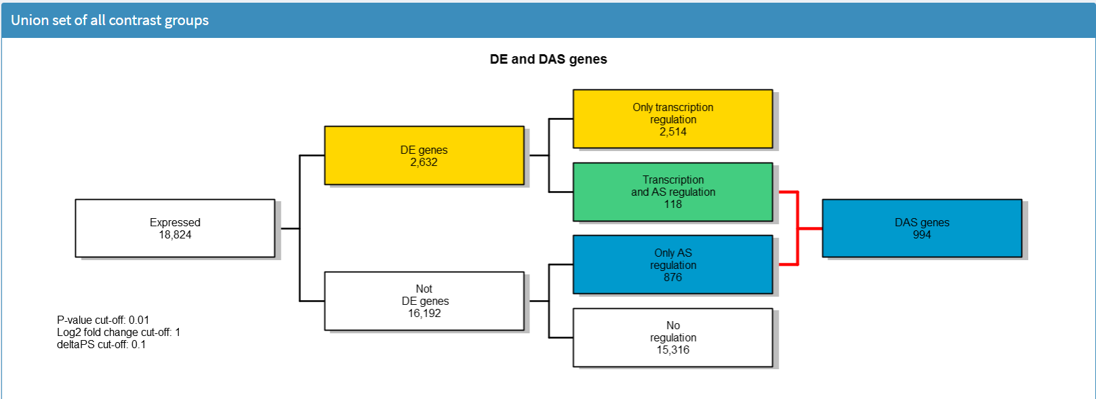
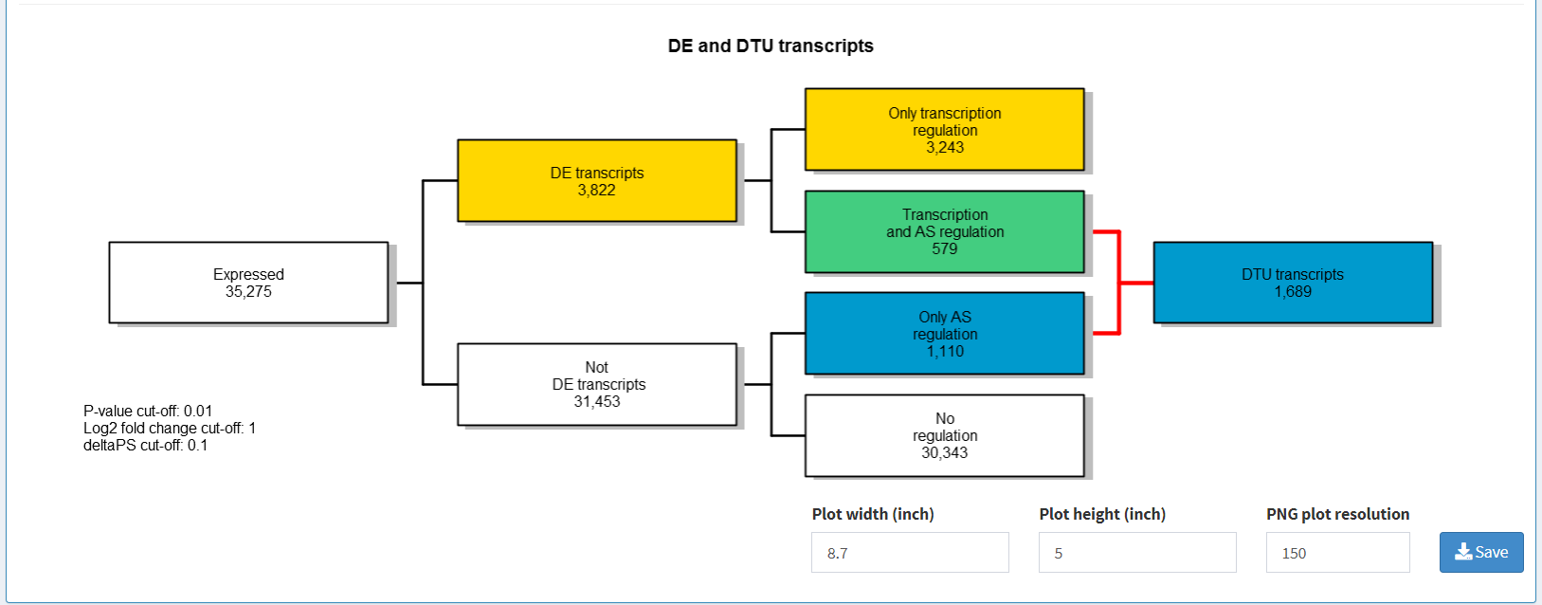
How to use 3D RNA-seq App?
Result summary page – Plot of significance
Flowchart of union sets of DE genes/transcripts, DAS genes and DTU transcripts across all contrast groups

Slide 35
How to use 3D RNA-seq App?
Result summary page
Click Advanced plot

Slide 36
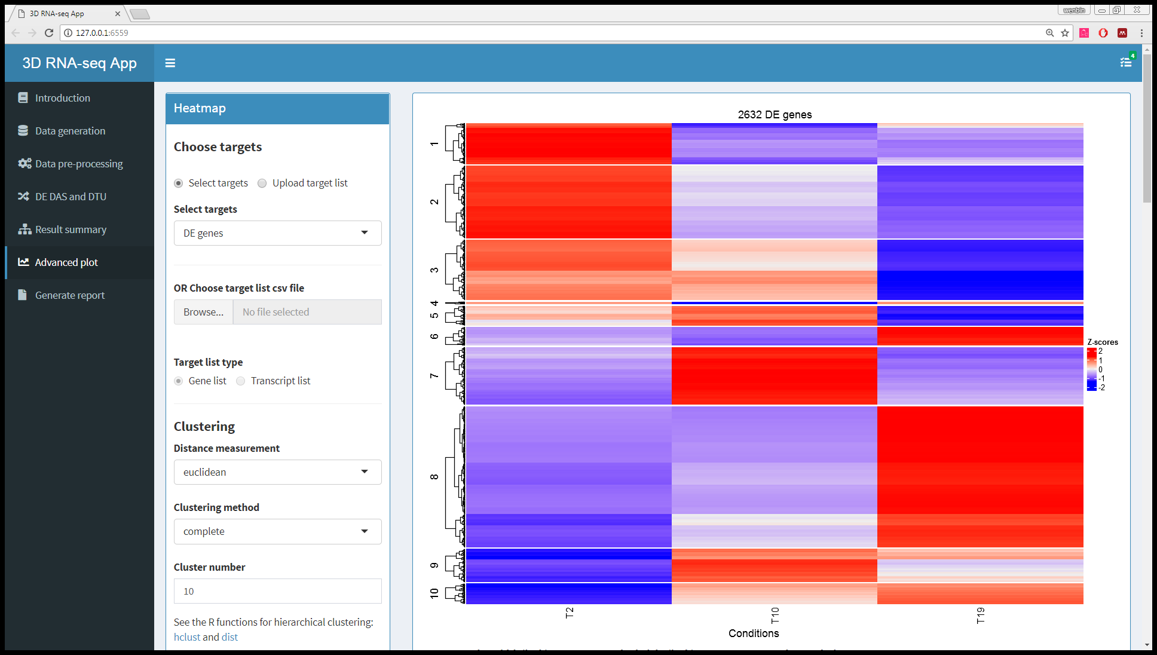
How to use 3D RNA-seq App?
Result summary page

Slide 37
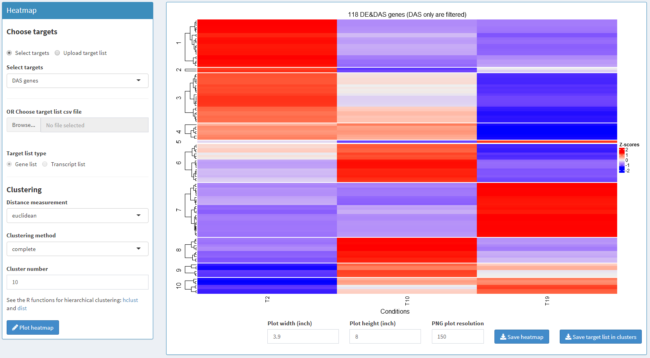
How to use 3D RNA-seq App?
Advanced plot page – heatmap plot
Select 3D list or upload gene or transcript list from local folder to make heatmap
Set clustering parameters

Slide 38
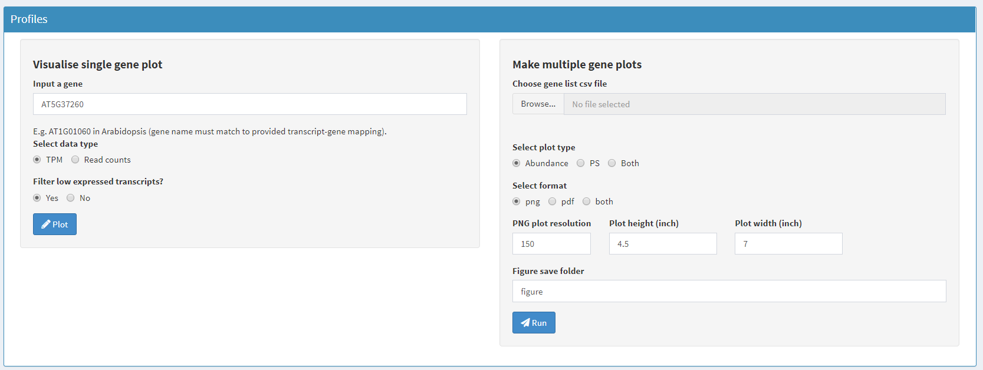
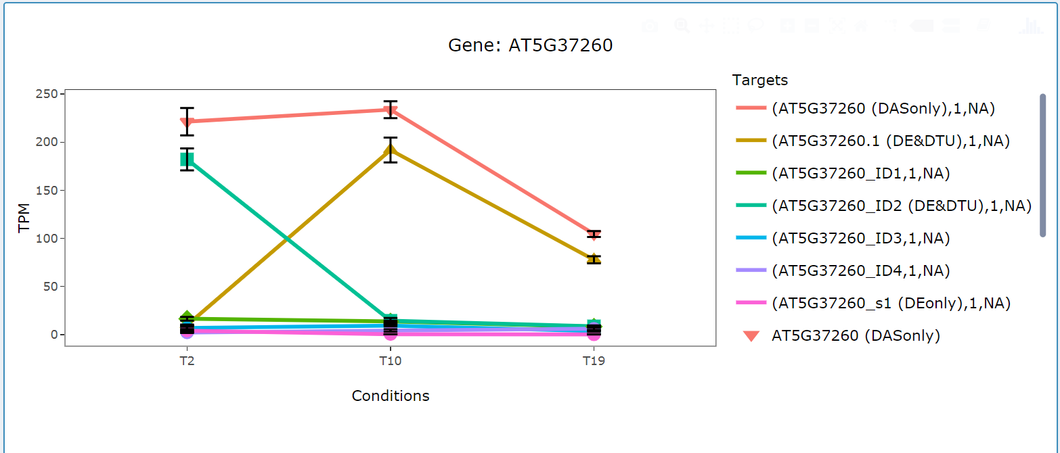

How to use 3D RNA-seq App?
Advanced plot page – expression profile plot
Upload a gene list to make and save multiple plot to defined folder
Type a gene name to visualise profiles and PS values based TPMs or read counts

Slide 39



How to use 3D RNA-seq App?
Advanced plot page – GO annotation plot
Example of GO annotation csv file
Save 3D list to local folder
Category
Annotation
Enrichment statistics
Upload GO annotation to make annotation barplot based on selected enrichment statistics
The length of GO term on y-axis can be changed.

Slide 40
How to use 3D RNA-seq App?
Result summary page
Click Generate report

Slide 41

How to use 3D RNA-seq App?
Generate report page

Slide 42


How to use 3D RNA-seq App?
Generate report page
Summary of parameters used in this App. If not correct, double click to edit
Click to generate report. Report in html, pdf and word formats will be saved to “report” folder.

Slide 43






How to use 3D genes/transcripts?
3D analysis application in Arabidopsis
Time-series isoform switch of DAS genes/DTU transcripts
App: https://wyguo.shinyapps.io/tsis_app/
Calixto et al., 2018
Guo et al., 2017
Transcriptional and AS regulatory networks
Novel cold-response genes
DAS genes – regulated only by AS
Dynamics of AS/transcription
Value of RTD to expression analysis
Keep eye on our publications

Slide 44




Acknowledgements
Runxuan Zhang
Wenbin Guo
John Brown
Cristiane Calixto Nikoleta Tzioutziou
Juan Carlos Entizne
Scottish
Government
Runxuan.Zhang@hutton.ac.uk
Wenbin.Guo@hutton.ac.uk

